Slide 1
INTRODUCTION TO DATA STRUCTURE

Slide 2
Lecture 1

Slide 3
Content
Basic Terminologies
Need of Data
What is Data Type?
Important forms of Data Types.
What is Data Structure (Definition)?
How to Choose particular Data Structure
Classification of Data Structure
Difference between Primitive DS and Non-Primitive DS

Slide 4
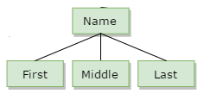
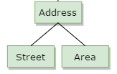
Basic Terminologies
Data : Simply value or Set of values.
Data item: Single unit of values. Those data item further sub divided are called group item. E.g. Name , Address etc.
Those data items that can not be further subdivided are called Elementary item. E.g. Age, Roll No etc.

Slide 5
Entity: Entity is something which exists in this real-world and whose information can be stored.
E.g. A student is an entity. The possible attributes of Student comprises of Roll no, Name, Gender, Age, Course etc.
Entity Set: Collection of similar entities. E.g. Students of a class, Employees of an organization etc.
Record: Collection of related data items. E.g. Roll no, Name, date of birth, gender, class of particular student such as 32, Ravi, 23/8/2005, M, 11. A record represents an entity.
File: Collection of related records. E.g. A file containing records of all students in class. In fact a file represents an entity set.

Slide 6
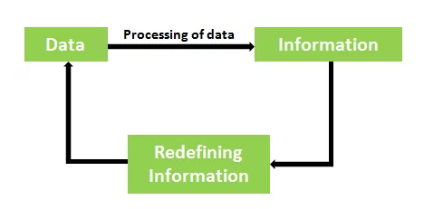
Need of Data
Data is a collection of raw facts which when refined gives information.
So, it is very difficult to draw a hold line that can differentiate the two terms “Data and Information”. we can get this concept through the following Diagram.
Therefore, we can convert data into information and again information into data means it is a cyclic process.
Data that is acting as information may act as data for another person or at another level while taking the decision.

Slide 7
Data Type
A Data type in a programming language is an attribute of data which specify computer (or programmer) important things about the concerned data. It declare
Set of values
Set of Operations
Integer: Whole Number, a number has no fractional part. It takes digits as its set of values and perform operation +,-,*, /,% etc. E.g. 12
Floating point: A number with decimal point. E.g. 12.4
Character: Readable text

Slide 8
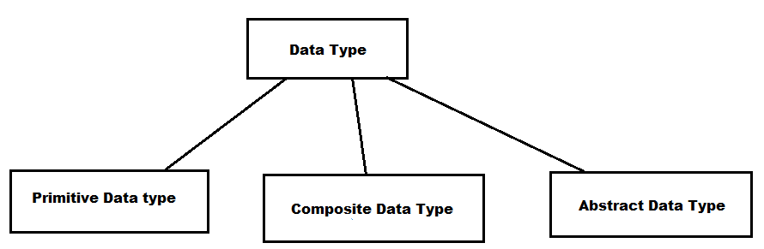
Important forms of Data types

Slide 9
Primitive Data Type
Basic data type or built in data type or simple data type.
Primitive data types are predefined. Need not to define data type before use.
E.g. C programming language provides built in support for integers (int, long), real ( float, Double) and characters (char).

Slide 10
Composite Data type
Assemble items of different types to create composite data types such as Structures, Arrays and Classes.
E.g. An array of Structure with array members.

Slide 11
Abstract Data Type
In Computing, an abstract data Type (ADT) is a specification of data and set of operations that can be performed on the data and this is organized in such a way that the specification of values and operations are separated from the representation of the values and operations on those values.
Some examples of ADT are Stack, Queue, List etc.

Slide 12
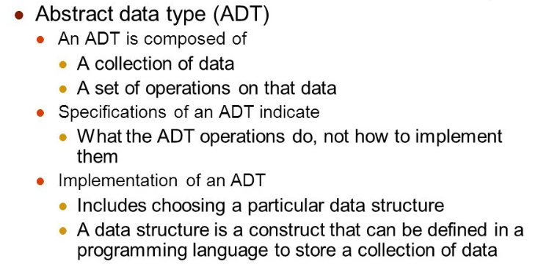

Slide 13
Let us see some operations of those mentioned ADT −
Stack −
isFull(), This is used to check whether stack is full or not
isEmpry(), This is used to check whether stack is empty or not
push(x), This is used to push x into the stack
pop(), This is used to delete one element from top of the stack
peek(), This is used to get the top most element of the stack
size(), this function is used to get number of elements present into the stack
Queue −
isFull(), This is used to check whether queue is full or not
isEmpry(), This is used to check whether queue is empty or not
insert(x), This is used to add x into the queue at the rear end
delete(), This is used to delete one element from the front end of the queue
size(), this function is used to get number of elements present into the queue
List −
size(), this function is used to get number of elements present into the list
insert(x), this function is used to insert one element into the list
remove(x), this function is used to remove given element from the list
get(i), this function is used to get element at position i
replace(x, y), this function is used to replace x with y value

Slide 14
Definition of Data Structure
The logical or mathematical model of data organization is termed as the data structure.
Logical or mathematical description of the structure of data.
Implementing this structure on a computer to perform a specific task.
Analyzing this structure in terms of time and memory required to implement it on a machine.
In Data Structures, Data may be organized in many different ways.
OR
It is a particular way of storing and organizing data.

Slide 15
How to Choose Particular Data Structure
The choice of particular data structure depends on two consideration.
It must be rich enough in structure to mirror the actual relationships of the data in real world.
The structure should be simple enough that one effectively process the data whenever necessary.

Slide 16
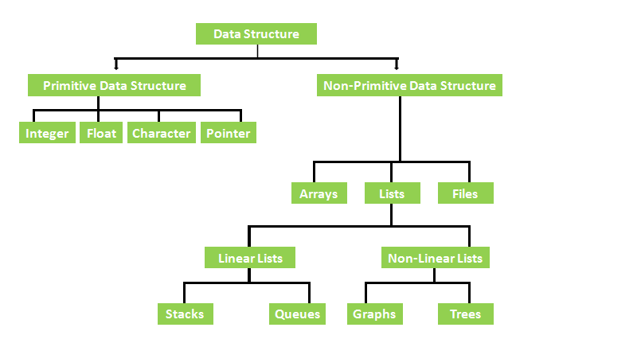
Classification of data Structure

Slide 17
Difference between Primitive Data Structure and Non-Primitive Data Structure
Primitive Data Structure | Non-Primitive Data Structure
These are basic structures and are directly operated upon by the machine instructions. | These are the more sophisticated data structure. These are derived from the primitive data structure.
These to general have different representations on different computers, Integer, Floating point numbers, character-constants, string constants, pointers, etc. | The non-primitive data structures emphasize the structuring of a group of homogeneous or heterogeneous data items.
Example of Primitive Data Structures with explanation Float Integer Character Pointer | Example of Primitive Data Structures with explanation Arrays Lists Files Stacks Queues Graphs trees

Slide 18
Lecture 2

Slide 19
Content
Difference between Linear List and Non Linear Lists
Brief Introduction of Data Structure
The most common operations performed on Data Structure

Slide 20
Difference between Linear List and Non-Linear List
Linear Data Structure | Non-linear Data Structure
In a linear data structure, data elements are arranged in a linear order where each and every elements are attached to its previous and next adjacent. | In a non-linear data structure, data elements are attached in hierarchically manner.
In linear data structure, single level is involved. | Whereas in non-linear data structure, multiple levels are involved.
Its implementation is easy in comparison to non-linear data structure. | While its implementation is complex in comparison to linear data structure.
In linear data structure, data elements can be traversed in a single run only. | While in non-linear data structure, data elements can’t be traversed in a single run only.
In a linear data structure, memory is not utilized in an efficient way. | While in a non-linear data structure, memory is utilized in an efficient way.
Its examples are: array, stack, queue, linked list, etc. | While its examples are: trees and graphs.

Slide 21
Brief Introduction of Data Structure

Slide 22
What is Arrays?
An array is defined as it is a collection of items stored at contiguous memory locations.
Arrays are the set of homogeneous data elements stored in RAM, therefore, it can hold only one type of data.
Therefore, the data may be all floating numbers or all characters or all integers numbers.
Therefore, array makes it easier to calculate, what is the position of each element by simply adding an offset to a base value.
Therefore, Single sub-scripted values are called linear array or one-dimensional array and two-subscripted variables are called as two-dimensional array.

Slide 23
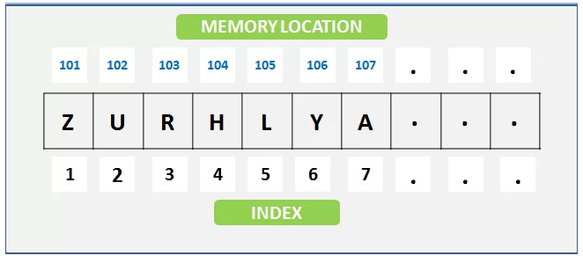
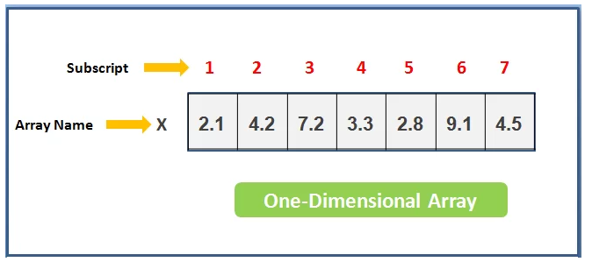

Slide 24
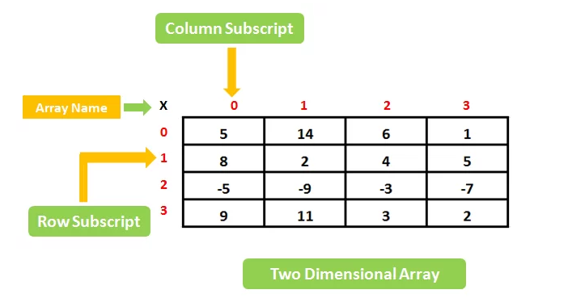

Slide 25
What is List
A Lists is defined as it is a collection of a variable number of data items. lists or sequence is an abstract data type, which always represents a countable number of ordered values.
Every list element contains at least two fields, one field is used for storing the data and another filed is used for storing the address of the next element.
Therefore we can say that lists are an example of containers. as they contain other values. if the same value occurs multiple times, then each occurrence is considered a distinct item.

Slide 26
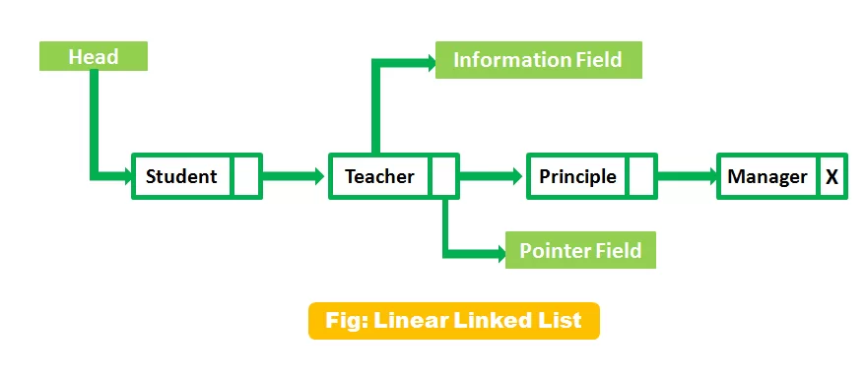

Slide 27
What is Files?
Files contain information, and this information stored permanently in the Hard Disk and Floppy Disk, this disk also knows as a secondary storage device.
User can store a little byte of data and a large amount of data in secondary devices.
Therefore, A file name always contains the primary and secondary name and dot(.) is used for separating. for understanding in a better way

Slide 28
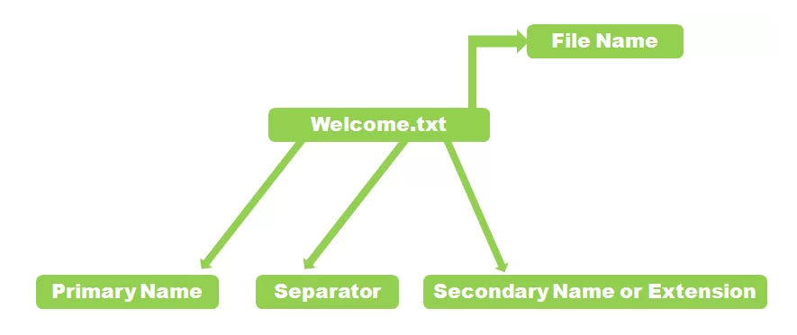

Slide 29
What is Stack?
A stack is a basic data structure, it’s defined as an ordered collection of elements represented by a real physical stack or pile. liner data structure features insertion and deletion of items take place at one end called top of the stack.
Therefore, In these structure data set as a stack of books or plates, in the stack, you can remove the item from the top order.
The implementation of the stack also know as LIFO (Last in First Out)
These are the three basic concepts that can be performed on stacks.
push (insert the items into a stack)
Pop (delete an item from the stack)
Peek (displaying the content of the stack)

Slide 30
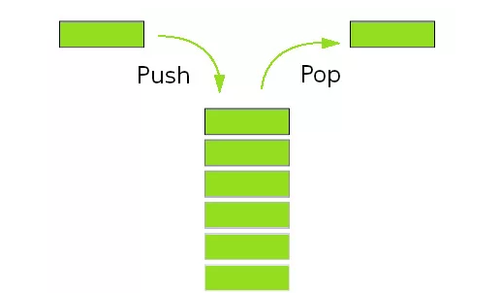

Slide 31
What is Queue?
Queue defined (FIFO) First In First Out type of data structure.
Queues are also the part of non-primitive linear data structure.
Therefore in Queues process, we can insert an element in a queue from the REAR end and delete an element from the FRONT end only.
E.g. Line at Reservation counter or ticket counter at cinema hall.
Therefore, Implement queues with using two ways:
Pointers
Arrays

Slide 32
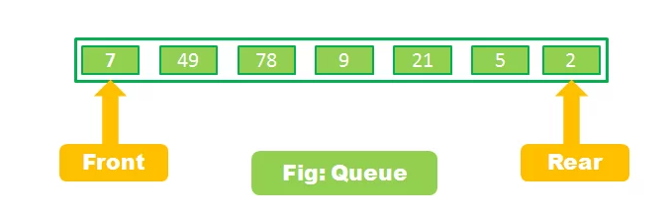

Slide 33
What are the Graphs?
Graph is defined as the collection of vertices and Edges. G=(V,E) where V is the set consist of vertices or nodes. E is the set consists of edges connecting vertices in graph.
There are different types of graphs :
Connected Graph
Non-Connected Graph
Directed Graph
Non-Directed Graph
Therefore, graphs are the non-linear and non-primitive type of data structure.
Graph is representing the different types of physical design structures such as used in Chemistry, physics, maths & Engineering Science.

Slide 34
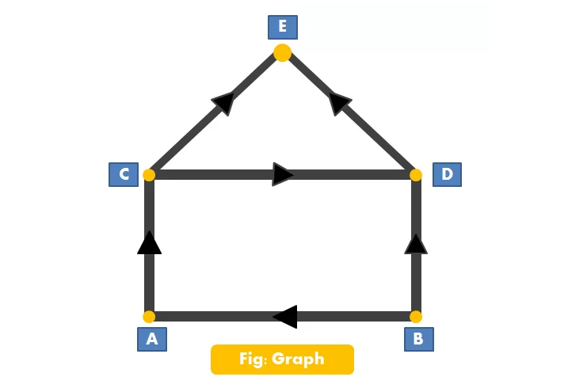

Slide 35
What are the trees?
In the classification of data structure, Trees also come in the non-primitive and non-linear category data structure.
Using tree we can represent a hierarchical relationship between the data elements.

Slide 36
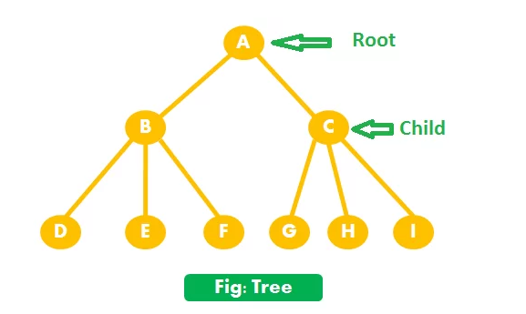

Slide 37
The most common operations performed on Data Structure
As a result, in the Classification of Data Structure, Data Structure the most commonly used operations are broadly categorized into four types: (1) Create (2) Delete (3) Selection (4) Update
CREATE operation
The CREATE operation (it can be defined) results in reserving memory for the program elements. This can be done by a declaration statement. The creation of data structure may take place either during compile -time or during Runtime.

Slide 38
DELETE operation
DELETE operation destroys the memory space allocated for the specified data structure Malloc() and free () as a result, the function of C language is used for these two operations respectively.
The SELECTION operation
The SELECTION operation can be defined as its deals with accessing particular data within a data structure. And the last operations
The UPDATE operation
UPDATE, as the name implies, it updates or modifies the data in the data structure. hence, in the Classification of Data Structure the operation Probably new data may be entered or previously stored data may be deleted.

Slide 39
So, in Classification of Data Structure, Other operations performed on data structure include:
(1) Searching (2) Sorting (3) Merging
Searching operation finds the presence of the desired data item in the list of the data item.
Sorting is the process of arranging all data items in a data structure in a particular order say for example, either in ascending order or in descending order.
MERGING is a process of combining the data items of two different sorted lists into a single sorted list.

